Slide 1
Power Ethiopia
Business plan
Prepared by:
Dr. Greg Beaucage
Professor of Chemical
and Materials Engineering
University of Cincinnati
Cincinnati, Ohio 45221, USA
Mr. Berhanu Mengistu
Lecturer of Physics
Haramaya University
Department of Physics
Haramaya, Ethiopia
Dr. Fekadu Lemessa
Academic Vice President
Dire Dawa University
Dire Dawa, Ethiopia

Slide 2
Power Ethiopia
-Photovoltaics are missing in Ethiopia
high import tariffs
no financing
architectural adaption
no technical support
aversion to new technology
no sales team
-Solve these issues using University Resources
manufacture PV panels
train technologists/business people
profit for faculty and students
-HU/DDU area is unique for this opportunity

Slide 3
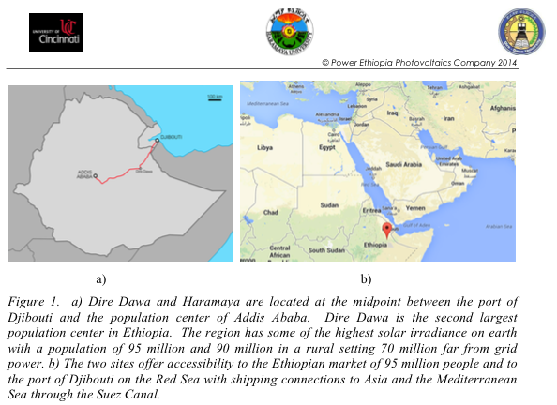

Slide 4
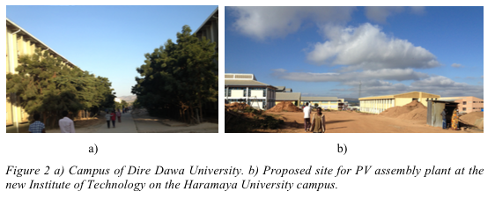

Slide 5
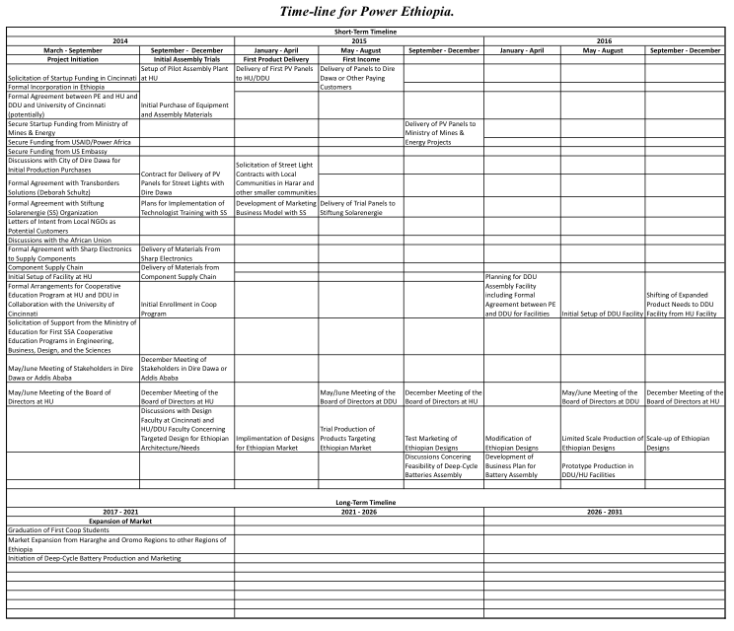

Slide 6
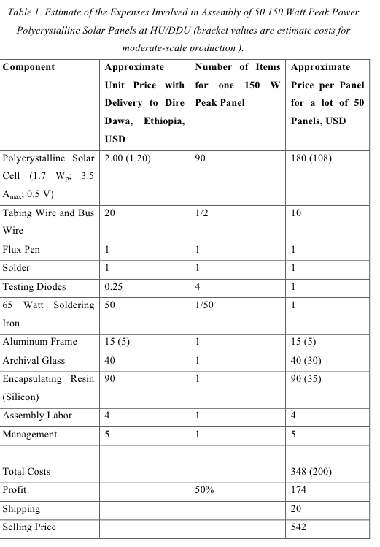

Slide 7
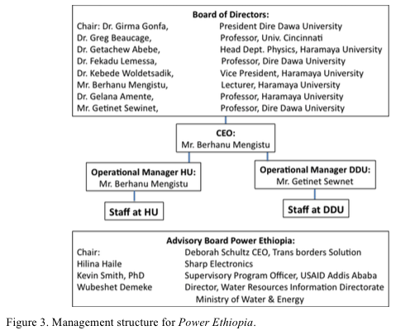

Slide 8
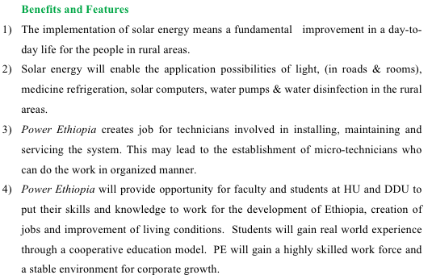

Slide 9
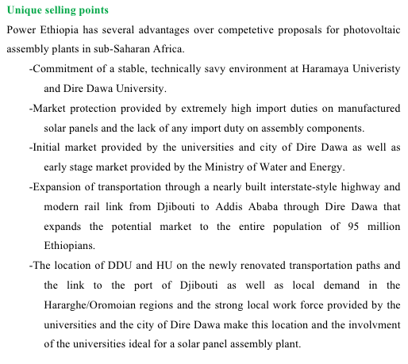

Slide 10
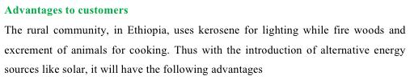
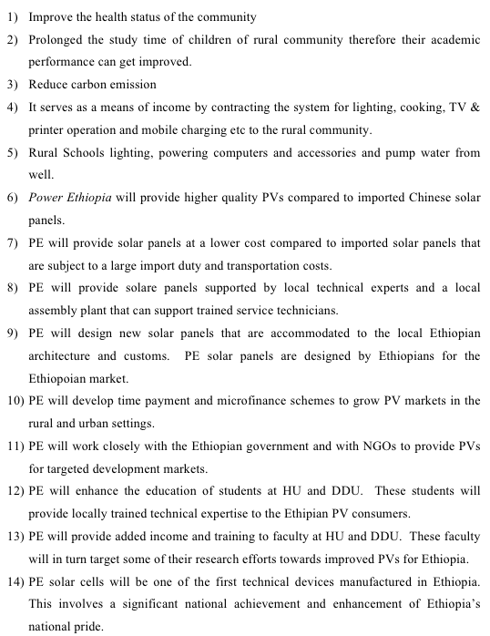

Slide 11
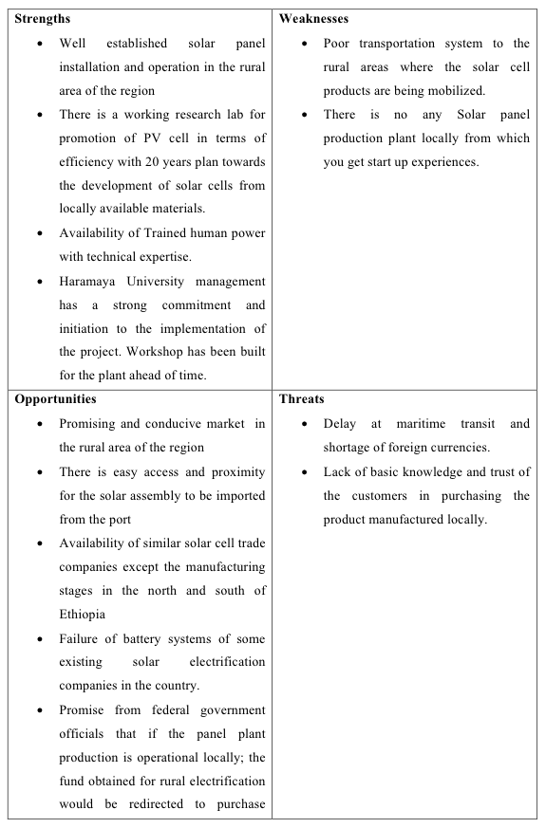

Slide 12
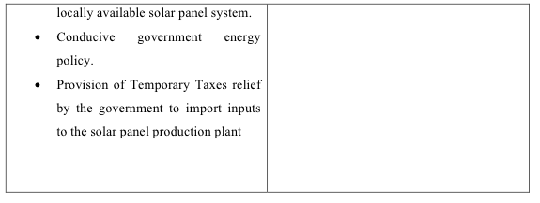

Slide 13
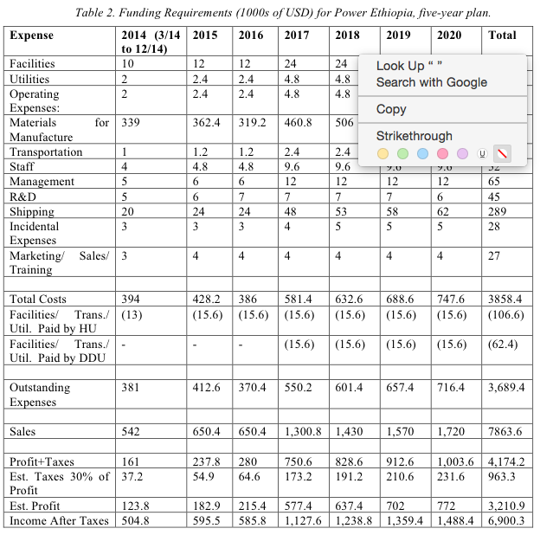

Slide 14
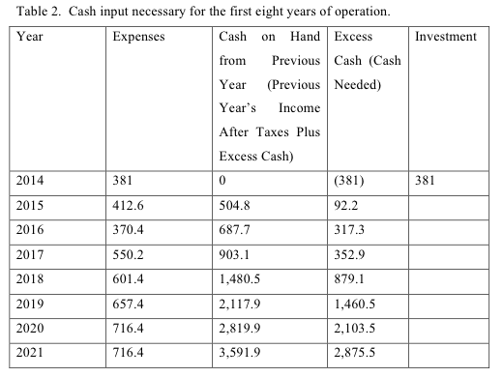

Slide 15
